Slide 1
Intro to C++ and Competitive coding
Aman Kumar Gupta
Bhushan Khanale
Shivank Pathak

Slide 2
Layout of today’s session:
Basics of C++
Syntaxes.
Headers and libraries.
Sample code.
Compilation.
Arrays.
Benefits
Competitive coding and Online Judges + practice.
Debugging your code and tackling errors.
Corner test cases practice.

Slide 3
Syntaxes:
C C++
printf(“Hello world”); 1. cout<<”Hello world”;
int x; 2. int x; scanf(“%d”, &x); cin>>x;
printf(“Hello again %d”, x); 3. cout<<”Hello again”<<x;
float y; 4. float y;
scanf(“%f”, y); cin>>y;
5. printf(“%.2f”, y); 5. cout<<fixed<<setprecision(2)<<y;

Slide 4
Header files
#include <iostream> // Basic input / outputs.
#include <string> // C++ provides a string class which is lot convenient than using character array.
In the next session:
#include <vector>
#include <set>
#include <map>
#include <unordered_map>
#include <unordered_set>
#include <algorithm>
And blah blah blah…...

Slide 5

Oh gosh, there so many.
How will I remember which one to use?

Slide 6

#include<bits/stdc++.h>

Slide 7
A sample code in C++
Print “Hello world”?
Add two numbers?
Naah!! Yahi karna hai to C se alag kya hai?
Let’s try with something that you don’t have in C.

Slide 8
Q. Print “Z_llaB_nogarD” in reverse order and print the middle character.
Link to code: https://ideone.com/fBVncv

Slide 9
Compilation:
From terminal:
Execute “g++ File_name.cpp” from your terminal at the same directory where you have created your C++ file to compile.
Execute “./a.out” from your terminal in the same directory where you have compiled your code.
2. In code blocks: Press on “Build and run” icon on top.

Slide 10
Arrays:
Same as in C.
Declaring format: int arr[20];
Initializing: int arr[5] = {1, 2, 3, 4, 5};
Accessing format: a[3] = 100;
Printing: cout<<a[4];
cout<<a[8] ??

Slide 11
Wrong: Right:
void checkArray(int a[][]) { void checkArray(int a[][5]) {
cout << ”Fine”; cout << ”Fine”;
} }
int main() { int main() {
int a[5][5]; int a[5][5];
for(int i = 0; i < 5; i++) { for(int i = 0; i < 5; i++) {
for(int j = 0; j < 5; j++) for(int j = 0; j < 5; j++)
a[i][j] = 1; a[i][j] = 1;
} }
memset(a, 1, sizeof(a)); memset(a, 1, sizeof(a));
checkArray(a); checkArray(a);
return 0; return 0;
} }

Slide 12
Why prefer C++ over other languages?

Slide 13
Fast: C/C++ are super fast compared to other languages.
Powerful libraries: C++ provides very strong and easy to use libraries which makes our work lot easier.
Extensible support everywhere: C++ is everywhere. From compilers to softwares. Lots of languages are built over C++.
Scope: When appearing in companies, having C++ as a strong point is pretty helpful, and its the most basic knowledge anyone would ask.

Slide 14

Competitive Programming

Slide 15
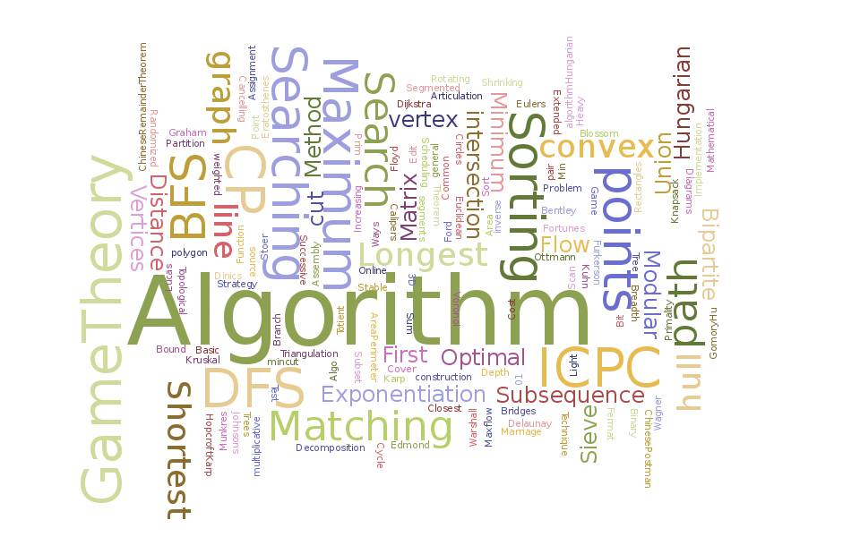
So…what is competitive programming?
> It's just programming, to be honest.
> You write code, run it, check it and submit it. Voila!
> Get an AC else repeat the above point.
> This is a nice picture :P

Slide 16

Okay, so what are we writing code for?
> Problems.
> Logical, mathematical, algorithmic, you name them :D
> They vary by difficulty. So you can start from easy and then move towards higher difficulty levels.
> You can move with your own pace, no hurry :-)

Slide 17
What is the objective here?

Slide 18

Do you know him? Be like him!

Slide 19
Here are the objectives
> Well competitive programming actually acts as a basic building block for your career as a software developer.
> The algorithms, data structures we use here are actually used in almost every other application software.
> Say for example Facebook search. The search is actually using a prefix trie data structure behind it to efficiently search your query through the billions of text data.
> You’ll learn prefix trie data structure in competitive programming.

Slide 20
Enough, now I need to know the BENEFITS!

Slide 21

Fine, here are the benefits
> You will enjoy once you start, there’s fun in getting ACs.
> You would improve your logical skills, these are important.
> You would know how to get the most complicated stuff done very easily.
> You would have the most knowledge of a language, they are built with lot of useful stuff. You just need to know them.

Slide 22
Mate, I need to know the ^actual^ BENEFITS!

Slide 23
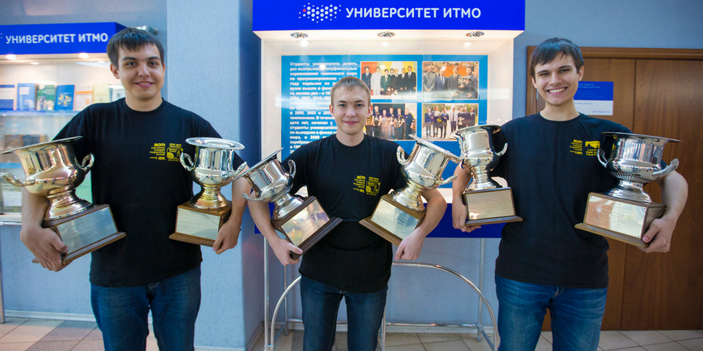
How would this feel?

Slide 24
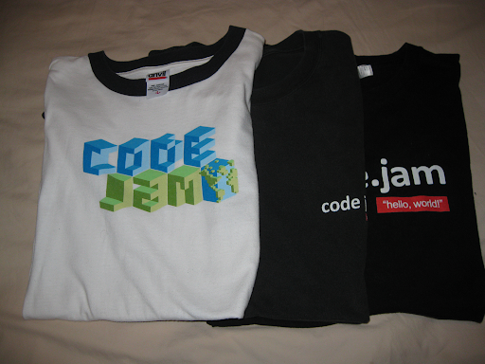
Fine mate!
> You can get yourselves paid, very high actually. Just look for long challenge prizes.
> There are goodies everywhere, free t-shirt supply for the rest of your life :P
> Get recognized by everyone, its a pro feature.
> Easy peasy job interviews, get your dream job :D
> Want more? search for yourselves ;)

Slide 25

So, how do I get started?
> Let’s have a look at the competitive programming sites first.
> There are plenty sites, start from where you feel comfortable.
> I would suggest these:
CodeChef
HackerRank
Codeforces
Topcoder
HackerEarth
> For this session, we’ll start from CodeChef.

Slide 26
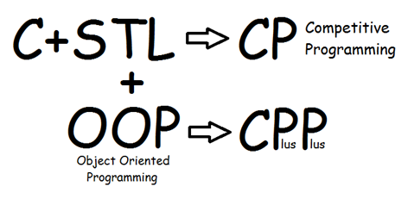
How do I get started?
> First make yourselves comfortable with at least one programming language.
> Languages play a very vital role in competitive programming since its about speed and accuracy here.
> C++ is highly recommended language though you can solve problems in almost any language now.
> Once you know how to write code, you are good to go.

Slide 27
How do I get started?
> So. let’s just get started with one of the problem from CodeChef and give you a taste of it.
> Let’s start from very basics:
https://www.codechef.com/problems/INTEST

Slide 28
Verdicts
> AC (Bingo!)
> WA (Shit!)
> TLE (F*ck!)
> CE (Stupid -_-)
> RE (WTF?!)

Slide 29
Tackling errors / Debugging
Types of errors you’ll face:
> Runtime Error (RE), Segmentation Fault (SISGEV) - Look for any invalid division (say, n / 0), or accessing out of bounds in an array, declaring wrong size of your container, allocating a very very large array memory.
> Compile-time error (CE) - Look at the console log and sort everything out one by one. Some possible general ones: using a variable not defined previously, passing wrong parameters to functions, multiple declaration of variables / functions etc.
> Wrong answer (WA) - Well, you have to think and sort it out yourself :p

Slide 30
Test Cases
But we wouldn’t be so rude to you by telling to figure it all by yourself ;)
Let’s take an example to see what causes WA and how to think critically about the corner test cases. Wait...what the hell is “corner test cases”?
These are some test cases which may follow a slight variation from your normal logic. Ex: To check a prime number, you’ll run a loop from 1 to N and check its divisibility by all numbers. If its 2, then its a prime number, else no.
But wait..does 1 follow this normal logic? No. This is called corner case.
Question: https://www.codechef.com/problems/HS08TEST

Slide 31
Variable overflow
int - The range for integer type is from -2^31 to 2^31-1=2147483647, so when n <= 1000000000 (10^9), it is fine.
long long - For n >= -10^18 and n <= 10^18
unsigned long long - For n >= 0 and n <= 10^19

Slide 32
Any Questions?

Slide 33
So let’s meet in the next session with the backbone of C++ and one of the most important and interesting things in Competitive Coding -
C++ STL

